Slide 1
Website and an App for Tourist Destinations of South India
Slot:B2
Guided by
RAJASEKARAN.V

Slide 2
Group Members
G.SAI SUSANTH-16BCE1047
K.SAI PHANINDRA -16BCE1075
M.MADHU SUDHAN REDDY-16BCE1016
T.SAI ANIL-16BCE1318
V.BHAGAVAN KUMAR-16BCE1353
C.SREEKANTH REDDY-16BCE1362

Slide 3
Overview:
Many foreigners and also North Indians who visit South India have one common problem! Most of the people finds it difficult in communicating through their native language. So we came up with this idea of making a website and a mobile application on “Famous tourist attractions of South India”.
We do have many websites available in internet for getting this information. But the problem most of them have information regarding popular tourist places. So we decided to integrate more sites which have historical importance but are not mentioned in those websites. Also our website is purely based on heritage sites of South India .So the people who are interested to visit places which shows the cultural and architectural values of South India can make use of this website and app.

Slide 4
Individual Contribution(Sai Phanindra -16BCE1075):
I have collected information and HD images of the state Tamil Nadu.
Firstly collected all the important cities of the state such as Madurai, Tirunelveli, Darasuram, Salem and many more.
Collected all the heritage places of particular city which are around 150 kilometres from the city.

Slide 5
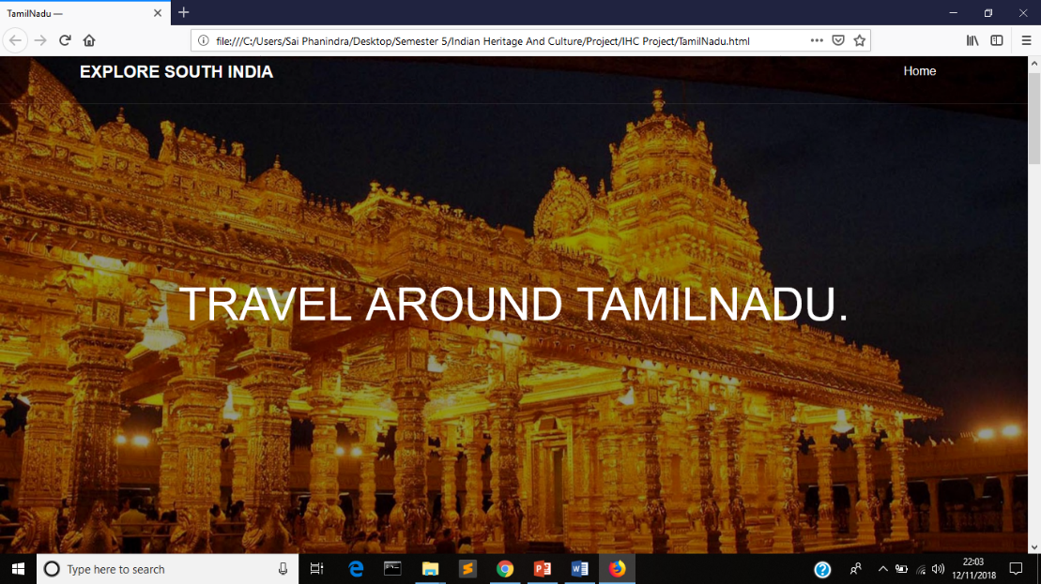
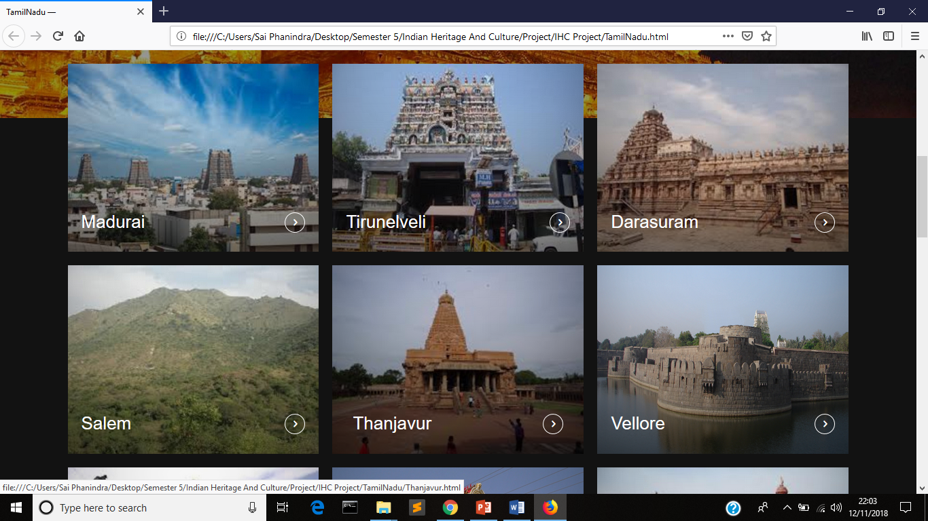
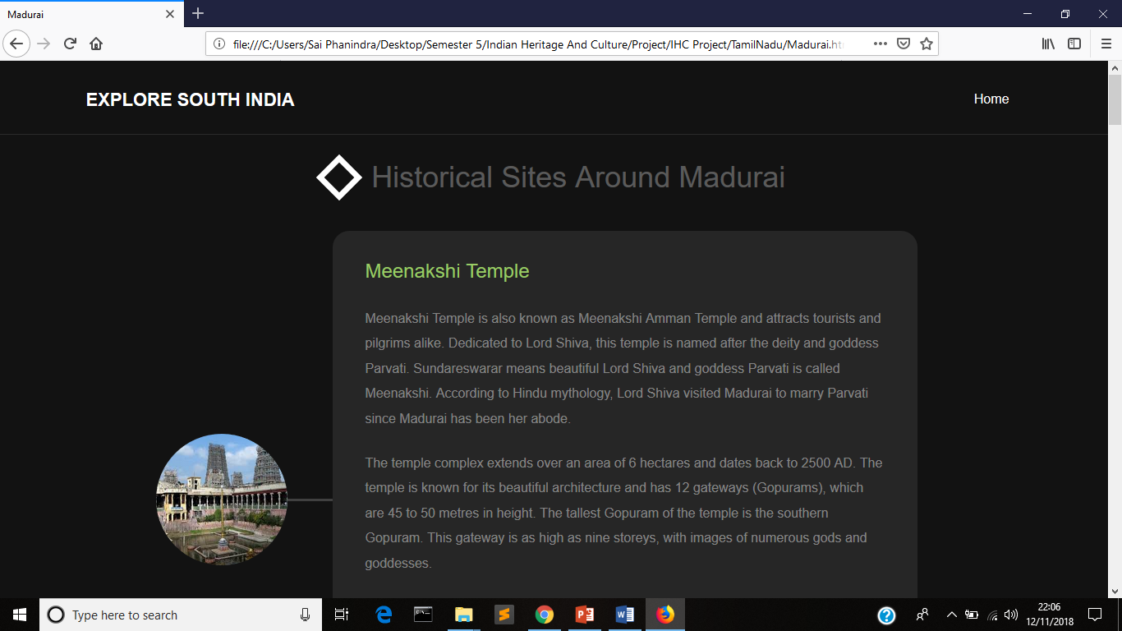
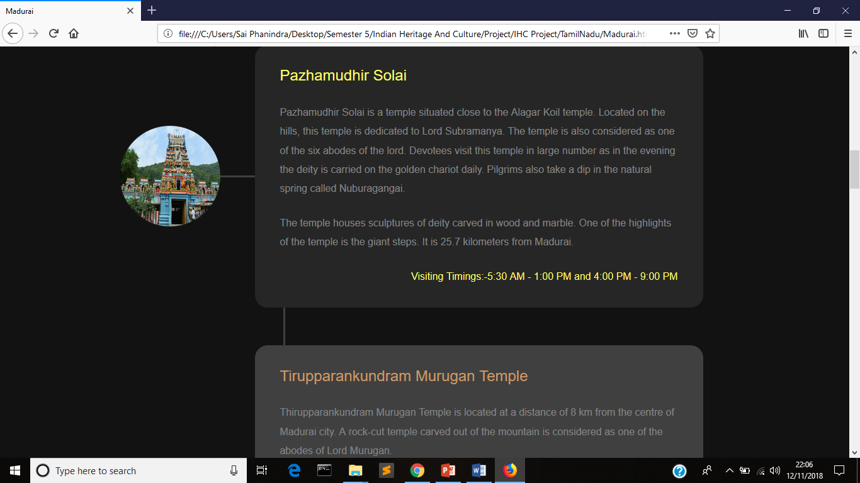

Slide 6
Thanking You

